Slide 1
Dark web and cybercrime
Unit: Cyber threats

Slide 2
Objective
I can describe the dark web and how cybercriminals operate.

Slide 3
Keywords
The dark web is a hidden part of the internet that cannot be found using normal search engines and is often used for secret activities.
Cybercrime involves using computers or the internet to break the law, such as stealing information or money.
An illegal marketplace is a website where people buy and sell things that are against the law, such as stolen data or fake IDs.

Slide 4
What do you already know?
The internet is made up of websites, online services and networks that connect people and information.
Personal data can be valuable to criminals if it is stolen or leaked online.
Cyber attacks can target individuals, businesses and governments.
Passwords and security measures help protect online accounts from being hacked.

Slide 5
Steps to success
The dark web
Stolen data
Risks

Slide 6
The dark web
Normal online activities
Risky online activities
Buying trainers from a well-known online shop
Sending an email to your teacher using your school account
Streaming a film on Netflix
Using the search engine DuckDuckGo to find homework help
Uploading photos to your private Instagram account
Accessing your school’s homework portal with your password
Downloading a free game from an unknown website
Clicking on a link in a message from someone you don’t know
Using a special browser to visit websites not found on Google
Buying “discount” passwords for games from a chat group
Sharing your login details with a friend so they can use your account
Trying to access a website that promises free exam answers

Slide 7
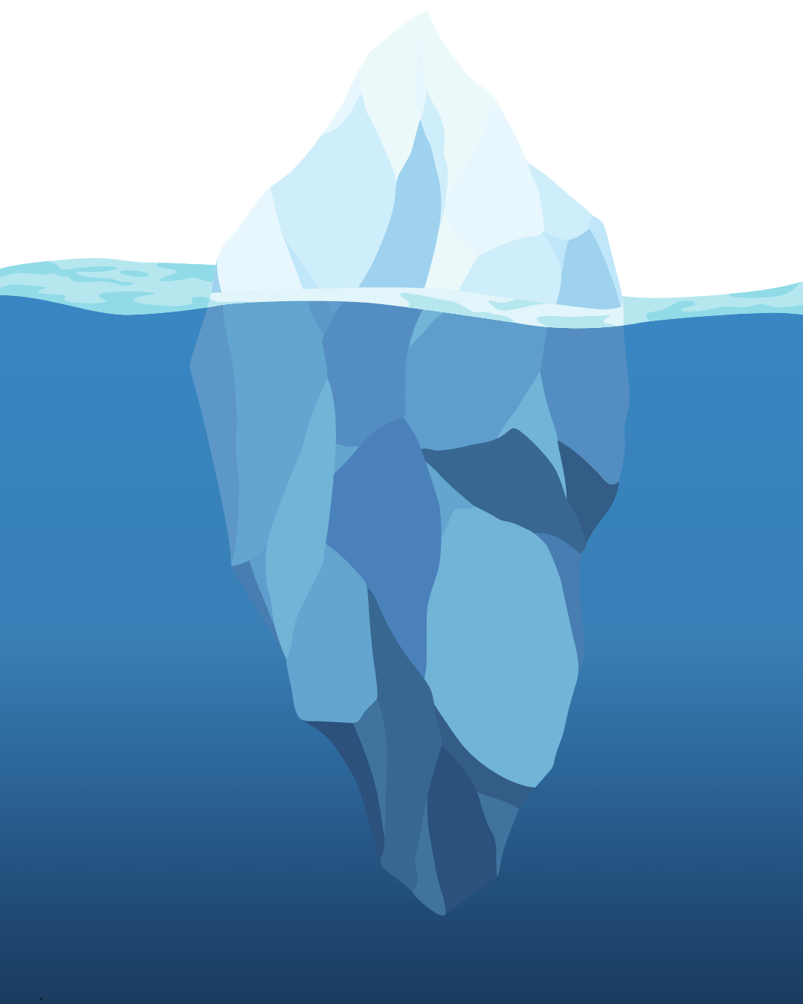
The dark web
Did you know the internet has different layers?
Think of the internet like an iceberg:
The top is what everyone sees.
There is much more that is hidden.

Slide 8
The dark web
The surface web is the part of the internet you use every day.
Websites you find on Google, Bing or Yahoo
News, social media, online shopping and school websites
Everyone can access these pages easily.

Slide 9
The dark web
The deep web is made up of pages that are not indexed by search engines.
The school’s homework portal
Emails systems
Online banking
You need a password or special link to access these, but they are legal and used for privacy.

Slide 10
The dark web
The dark web is a hidden part of the internet.
You need a special browser (such as Tor) to get there.
Not everything on the dark web is illegal, but it is where a lot of cybercrime happens, including selling stolen data and illegal goods.
It’s hidden for privacy, which means it attracts criminals.

Slide 11
The dark web
Why do you think some people want to hide their online activities?
Some people want to hide their online activities because they care about their privacy and don’t want others to see what they’re doing, especially if it’s personal or sensitive. They may be doing research that they do not want to make public yet.
Others might want to avoid being tracked by companies or governments.
Unfortunately, some people also hide their activities because they are doing something illegal or breaking the rules online. So, people use hidden parts of the internet for both good and bad reasons.

Slide 12
The dark web
The dark web does not appear in search engines such as Google, DuckDuckGo or Bing because the websites on the dark web are not indexed or listed by these search engines.
This means search engines can not find or show them in their results.
They simply do not know they exist.

Slide 13
The dark web
Websites on the dark web are designed to be hidden and can only be accessed using special browsers.
They use unique web addresses that are not shared publicly and often require extra steps to find or access.
You may have to be invited to see certain pages.
This keeps the dark web private and secret, which is why it’s used for both privacy reasons and by people doing illegal activities.

Slide 14
1: The dark web
Name two differences between the surface web and the dark web.

Slide 15
1: The dark web ANSWERS
Name two differences between the surface web and the dark web.
The surface web can be found using search engines such as Google, but the dark web cannot be found this way and needs a special browser to access.
Most websites on the surface web are public and legal, while the dark web is hidden and often used for secret or illegal activities.

Slide 16
Steps to success
The dark web
Stolen data
Risks

Slide 17
Stolen data
Cybercriminals use different tricks to steal information from people and organisations.
Hacking means breaking into computer systems to access private information.
Phishing is when criminals send fake emails or messages to trick people into giving away passwords or personal details.
Sometimes, they use viruses or malware to secretly collect data from computers.

Slide 18
Stolen data
Once cybercriminals have stolen data, they usually do not keep it for themselves.
They collect things such as passwords, bank details or personal information.
This stolen data is then secretly sold to others who want to use it for crime so many criminals will have access to the data.

Slide 19
Stolen data
There are hidden websites, called illegal marketplaces, where criminals buy and sell stolen information.
These sites are not found on Google and are on the dark web.
Transactions are often made using cryptocurrencies to hide identities.

Slide 20
Stolen data
On these illegal marketplaces, you might find:
Stolen passwords and login details
Credit card numbers and bank account information
Fake documents, such as passports or ID cards
Personal data, such as addresses and phone numbers
All of these can be used for further crimes, such as identity theft or fraud.

Slide 21
2: Stolen data
Complete each sentence by filling in the missing word from the word bank:
Cybercriminals often steal __________ information from people and businesses.
Stolen data, such as __________ details or __________, can be sold online.
Illegal __________ are hidden websites on the __________ where __________ buy and sell stolen data.
passwords | marketplaces | credit card
dark web | criminals | personal

Slide 22
2: Stolen data ANSWERS
Complete each sentence by filling in the missing word from the word bank:
Cybercriminals often steal __________ information from people and businesses.
Stolen data, such as __________ details or __________, can be sold online.
Illegal __________ are hidden websites on the __________ where __________ buy and sell stolen data.
passwords | marketplaces | credit card
dark web | criminals | personal
personal
credit card
passwords
marketplaces
dark web
criminals

Slide 23
Steps to success
The dark web
Stolen data
Risks

Slide 24
Risks
Scams are tricks used by criminals to steal money or personal information.
On the dark web, scams are common. People might sell fake products, promise something they never deliver or try to trick you into giving away your details.
If something sounds too good to be true, it probably is!

Slide 25
Risks
Viruses and malware are harmful programs that can infect your computer or phone.
Downloading files or software from unknown sources, especially on the dark web, can lead to your device being infected.
Only download from trusted sites and always use antivirus protection.

Slide 26
Risks
The dark web has websites that share illegal or disturbing content, such as stolen data, fake documents or worse.
Accidentally seeing or downloading illegal material can get you in serious trouble, even if you did not mean to.
Stay away from unknown or suspicious sites to protect yourself.

Slide 27
Risks
Cybercriminals on the dark web might try to target you if they get your information.
They could try to hack your accounts, steal your identity or trick you into giving them money.
Protect your personal details and never share them with strangers online.

Slide 28
Risks
Law enforcement agencies monitor the dark web to catch illegal activity.
If you access or download illegal content, even by accident, you could be investigated or face serious consequences.
Breaking the law online is still breaking the law. Always use the internet safely and responsibly.

Slide 29
Risks
How would you feel if your online activities were always being watched, even if you had nothing to hide?
Is it fair to punish everyone for the actions of a few criminals online? Why or why not?

Slide 30
Risks
What are the dangers if governments have too much power to watch what people do online?
In some situations, privacy is especially important (for example, for journalists, activists or people living in dangerous countries). How could new laws protect these people while still fighting crime?

Slide 31
Risks
Do you think it’s possible to have both freedom of speech and strong protection against cybercrime, or do we always have to give up some freedom for safety?
It is a difficult situation to impose laws on the dark web and online activities because there is a delicate balance between protecting people’s privacy and freedom of speech and stopping criminal activity.
Strong laws might help catch criminals, but they can also make it harder for ordinary people to keep their information private or speak freely, especially in countries where the government might misuse its power.

Slide 32
Summary of lesson
The dark web is a hidden part of the internet that is used for both legal and illegal activities.
Stolen data is often sold there in illegal marketplaces, where criminals buy it to commit more crimes such as identity theft.
Policing the internet is difficult because there’s a balance between keeping people safe and protecting privacy and free speech.
Today you used creative thinking, analytical thinking, curiosity, leadership and communication. These skills will help you stay safe online and prepare for a future where technology and AI play an even bigger role.

Slide 33
© 2025 Nichola Wilkin Ltd
https://www.nicholawilkin.com/terms

